Slide 1
Flights Delay Prediction using Machine Learning Models
Group 4

Slide 2
Problem Statement
Objective: Develop a robust machine learning model for predicting flight delays in the airline industry.
Context: The aviation sector faces the challenge of unpredictable flight delays, impacting both airlines and passengers. To address this issue, we aim to harness historical flight data along with relevant features like weather conditions, airport congestion, and flight schedules.

Slide 3
Contents
EDA
Data Preprocessing
Machine Learning Models
Evaluation Metrics
Recommendations
Challenges Faced

Slide 4
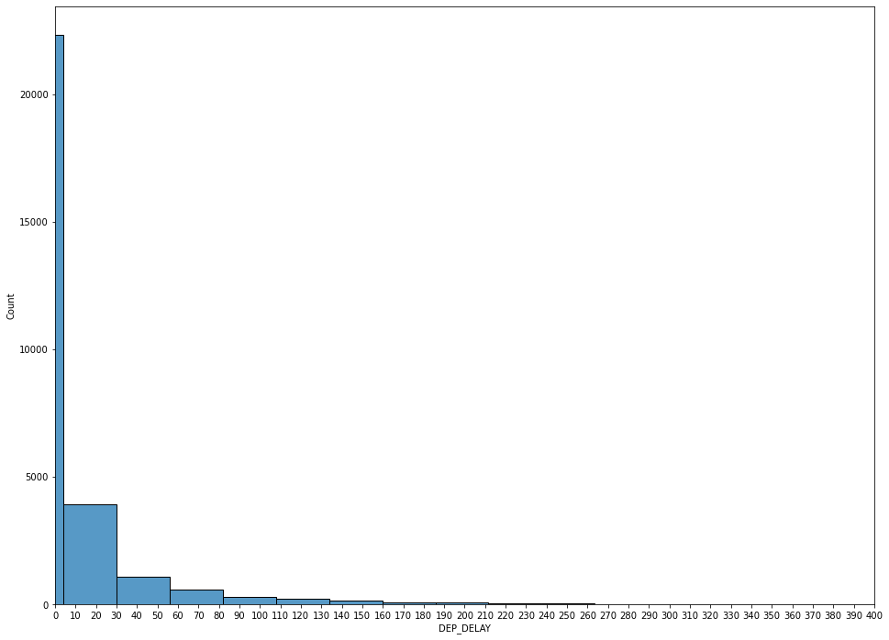
EDA
Distribution Of Target Variable

Slide 5
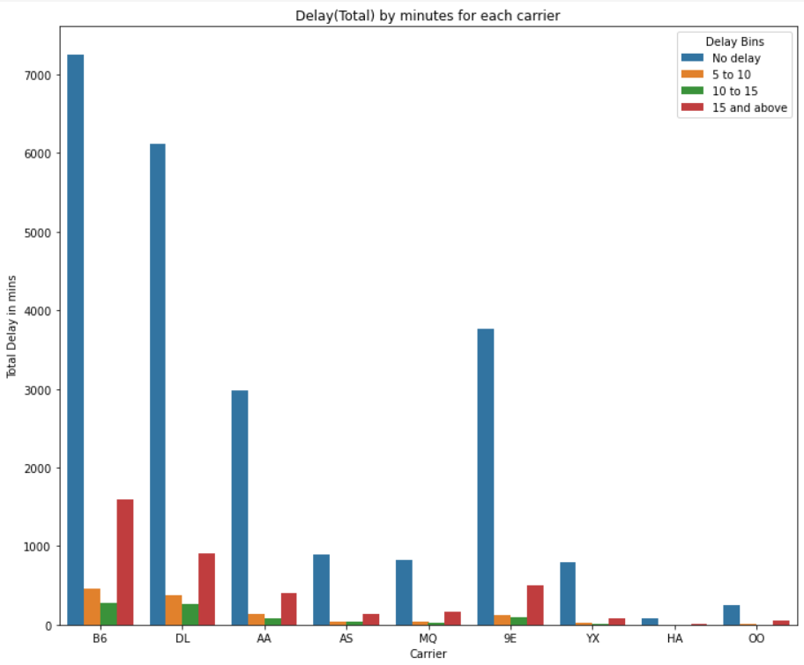
Delay Distribution For each carrier

Slide 6
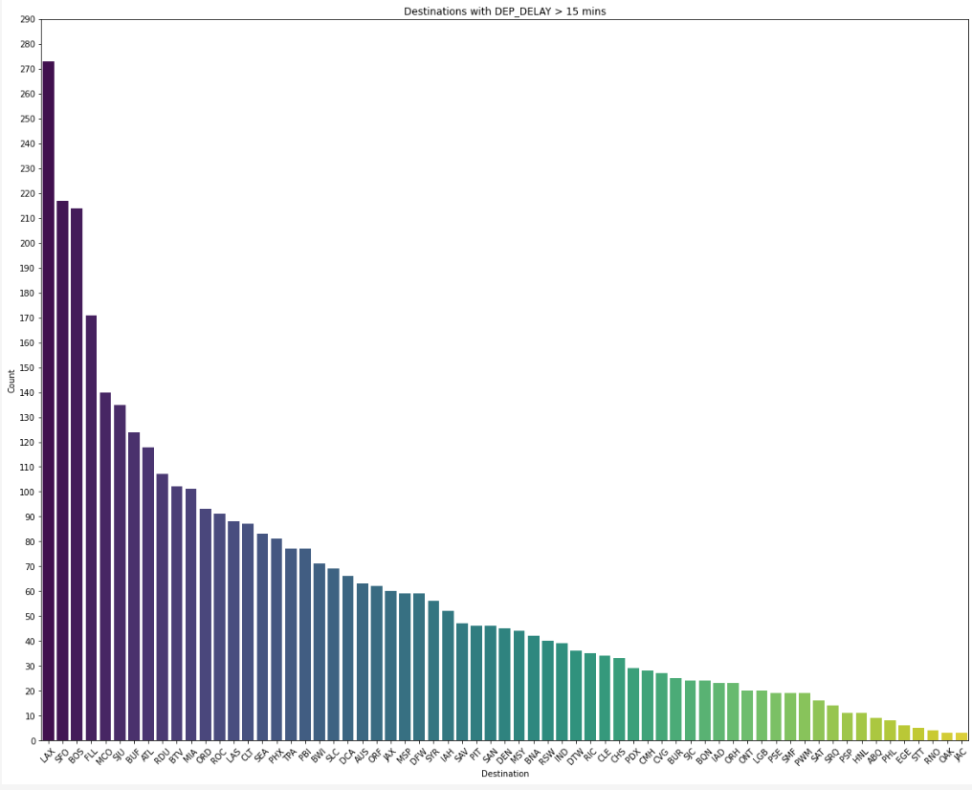
Flight Delay Distribution Across Destinations

Slide 7
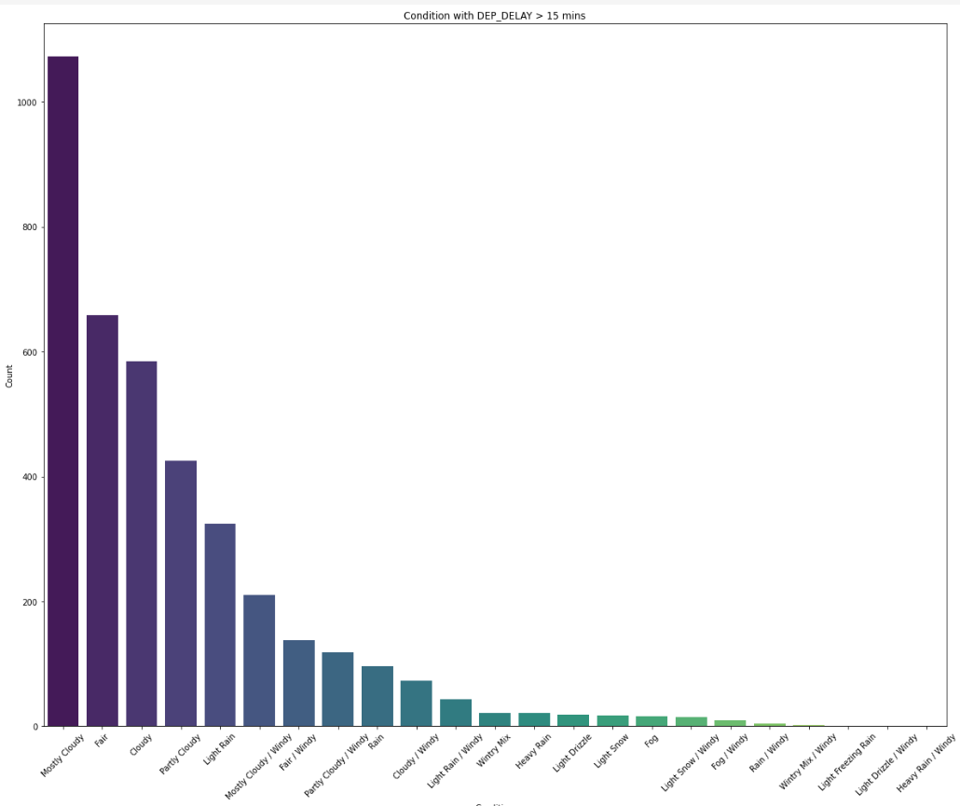
Impact of Conditions on Flight Delays

Slide 8
Data Preprocessing
Standardized column names
Removed duplicates and feature selection
Data mapping
Applied transformations using pipelines for missing values imputation , scaling and encoding

Slide 9
Machine Learning Models
We leveraged the PyCaret Library to gain a comprehensive understanding of various model’s performance on our dataset, providing an initial insight into model selection.
Upon analysis, XG Boost emerged as the top-performing model, prompting us to conduct individual runs of Logistic Regression, Decision Trees, Bagging, Isolation Forest, One-Class SVM, and XG Boost.
In the evaluation of these models, XG Boost consistently outperformed others in terms of accuracy, precision, recall, and F1 score metrics.
To further enhance performance, we implemented Hyperparameter tuning using GridCV.

Slide 10
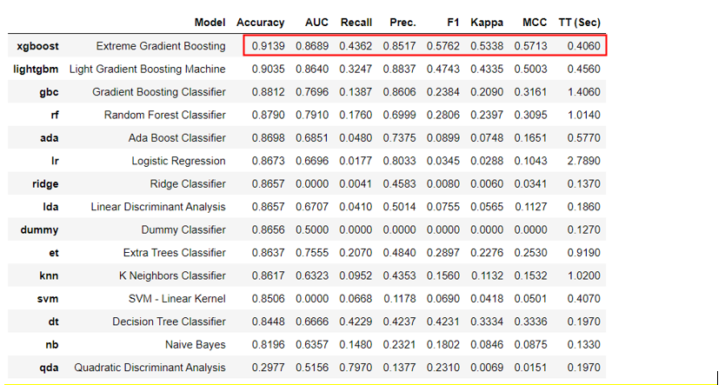
Evaluation Metrics
Pycaret Results:

Slide 11
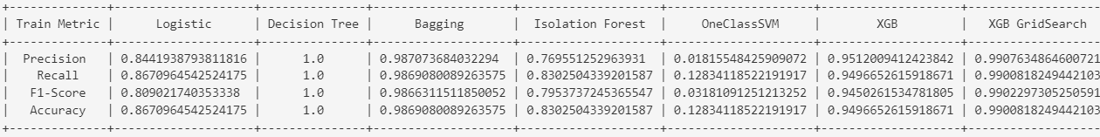
Evaluation Metrics
Training Data:

Slide 12
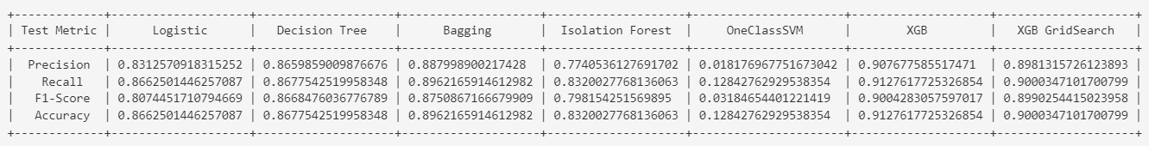
Evaluation Metrics
Testing Data:

Slide 13
Recommendations
Consideration of Seasonality: The feature "MONTH_DEC" (December) has the highest importance. It suggests that the month of December significantly impacts the outcome.
Destination-Specific Insights: Destinations such as Colorado, Florida, and the US Virgin Islands show notable importance.
Departure Time Influence: "CRS_DEP_M" (Scheduled Departure Time in minutes) plays a role in predicting outcomes.
Airline Carrier Impact: The carriers JetBlue Airways and Delta Airlines contribute significantly. We can collaborate with these carriers to understand operational practices and identify areas for improvement.

Slide 14
Weather Conditions Analysis: Weather conditions, particularly when it’s “Light Drizzle”, “Wintry Mix," and "Cloudy / Windy," has notable importance.
Airport-Specific Considerations: Airports such as Indianapolis, Dallas Fort Worth, and San Francisco show notable importance. We can analyze if there are airport-specific challenges or opportunities that can be addressed.
Operational Efficiency: Scheduled departure and scheduled arrival times are significant features. We can evaluate whether adjustments to scheduling can enhance operational efficiency and performance.
These recommendations aim to guide further investigation and operational improvements based on the insights gained from the feature importance analysis.

Slide 15

Challenges Faced
Encountering class imbalance in the dataset with fewer instances of delayed flights, we initially attempted oversampling without success. However, improving model performance was achieved by assigning weights to the positive class (delayed flights).

Slide 16
Conclusion
The XGBoost model excelled in predicting flight delays, unveiling crucial factors like seasonal patterns and destination specifics.
Its success highlights the transformative impact of machine learning in aviation, empowering stakeholders with actionable insights for operational optimization.

Slide 17


